Slide 1
Evaluation of well tests using radial composite model and Dietz shape factor
Hana Baarová
Technical University in Liberec, Czech Republic

Slide 2
Introduction
    Purpose of well testing
2. Radial Homogeneous Flow Model
Assumptions
Log-log diagnostic plot
Semi log diagnostic plot
Methods to obtain permeability (k), transmissivity (kh) and total skin
3. Radial Composite Flow Model
Scheme and assumptions
Acidization, gas fingering, moving water front
Log-log diagnostic plot
Semi log diagnostic plot
4. Dietz Correction Shape Factor
Assumptions
Cartesian plot – irregular drainage area, position of the well
Improvement in deliverability calculation
5. Conclusions

Slide 3
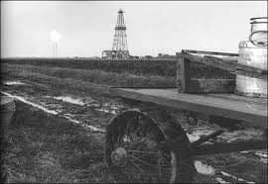
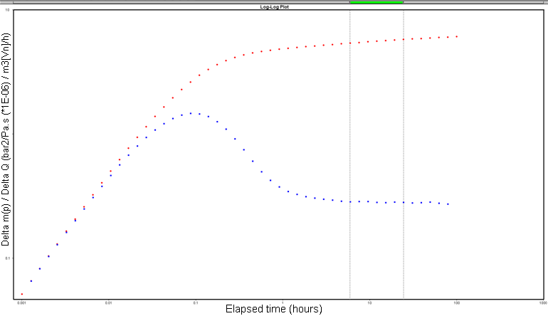
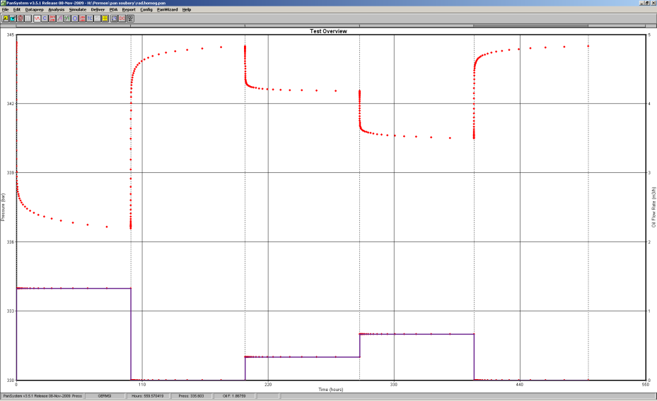
1. Introduction - Well testing workflow
Pressure transient analysis data (isochronal pumping test)
Transient data (build-ups)
Early time data (ETD) - wellbore storage coefficient
Middle time data (MTD) – flow model to get permeability (k) and total skin (St)
Late time data (LTD) – boundary model to estimate boundary condition
Deliverability – semi theoretical derivation of absolute open flow potential (AOF)
Flowing periods (drawdowns)
non-Darcy skin analysis - true skin (S) and rate-dependent skin (Sd)
Deliverability - LIT analysis to get AOF
www.goexpro.com
Log-log diagnostic plot
Test overview
MTD
ETD
Flow model
LTD
Boundary model

Slide 4
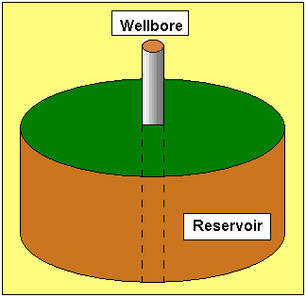


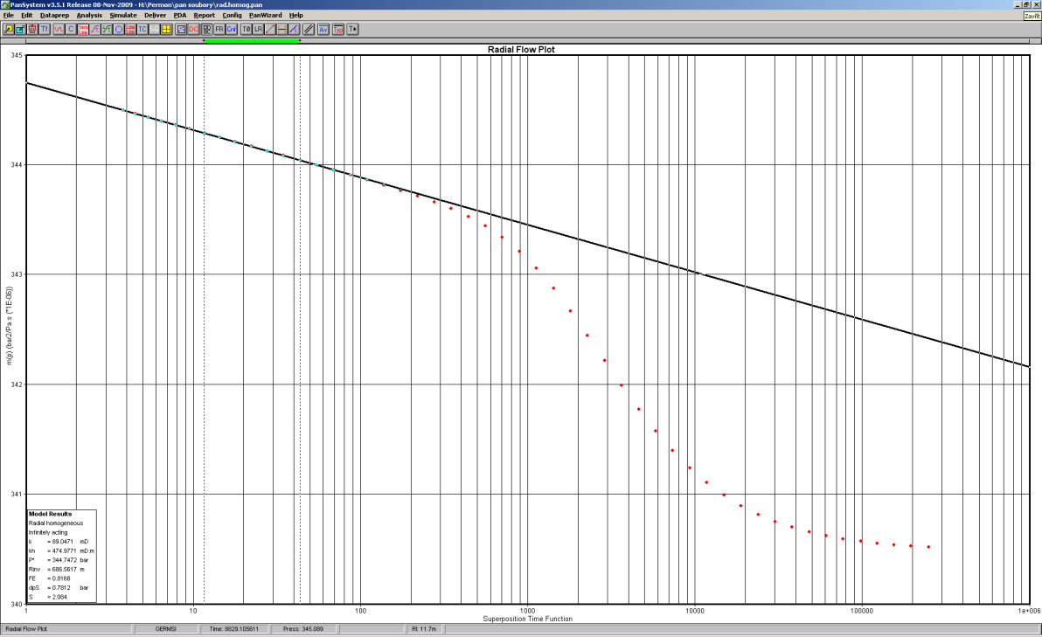
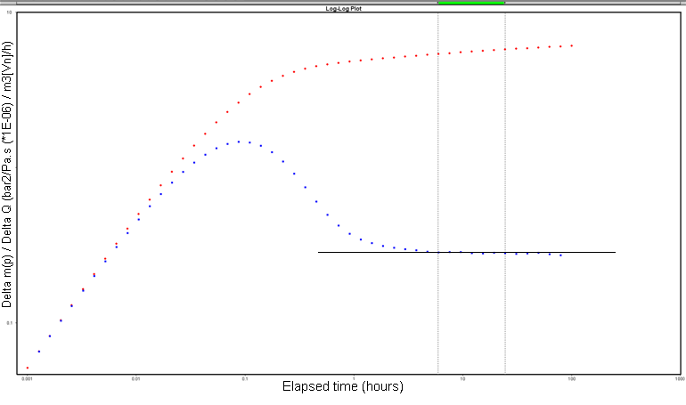
2. Radial Homogeneous Flow Model
  Cylindrical homogeneous reservoir with well situated in the middle
www.fekete.com
Semi log plot(Radial flow plot) of the last buildup
Results
For the layer: k, kh, p_{i}
For the well: s, Cs, Cd
Slope of the straight line m
Log-log plot of the last buildup
Lower k
Radial homogeneous flow regime
Wellbore storage effect
Decay of wellbore storage effect
Test overview
Heterogeneity?
Last buidup
Zero slope line

Slide 5

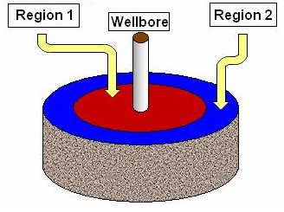
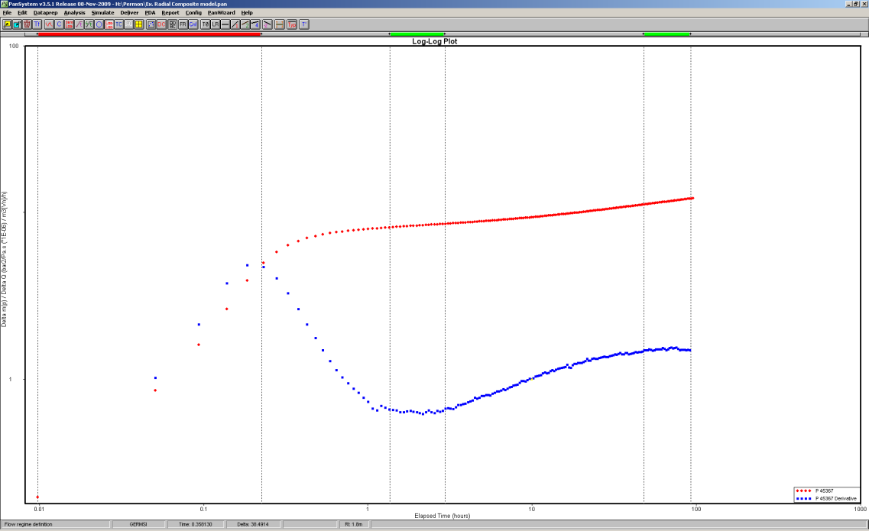
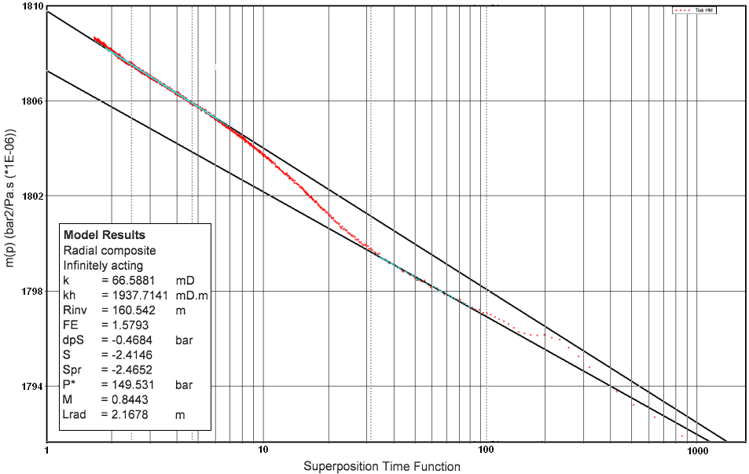



3. Radial Composite Flow Model
Inner and outer region
Due to acidization
Change in gas saturation: gas fingering , moving water front
Steam front, CO₂ miscible flooding front
www.siam.org
Lrad
www.fekete.com
Inner zone radial flow
Outer zone radial flow
Mobility ratio, Pseudoradial skin, Distance Lrad
Decrease in transmissivity
Short duration of WBS
(Not a double slope)
Mobility Ratio
Storativity Ratio
Distance to the radial discontinuity

Slide 6

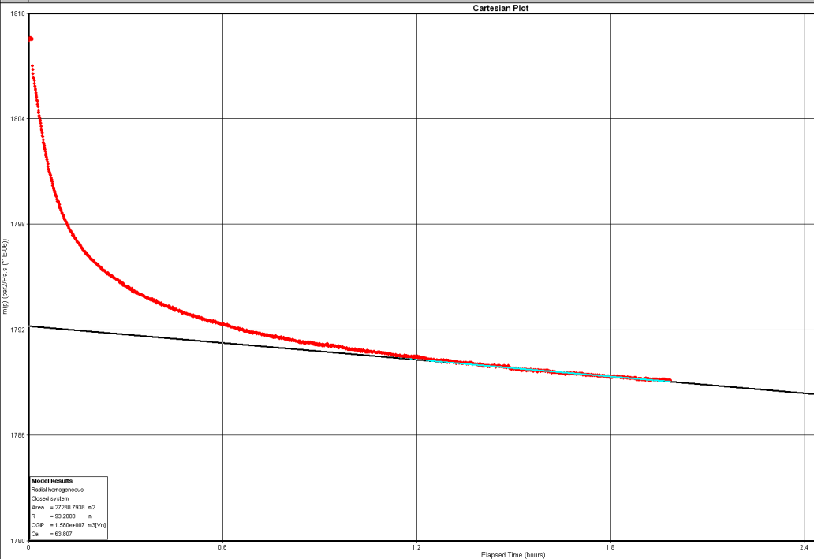

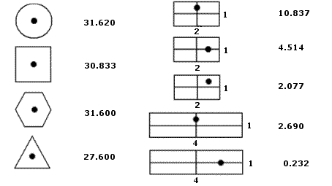
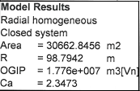
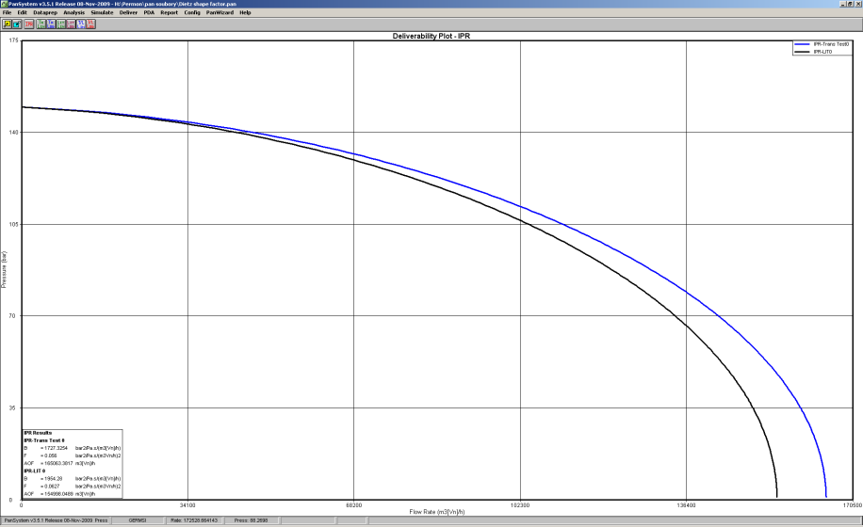
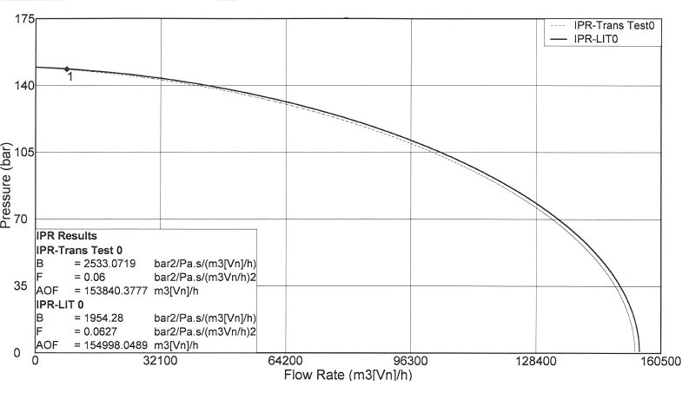
4. Dietz Correction Shape Factor C_{A}
Layer parameter, default value 31.62
Accounts for the drainage area shape and the well position
Better calculation of AOF transient, closed system
C_{A} estimated from the Cartesian plot of the extended drawdown
Default C_{A} = 31.62
C_{A} = 2.3473
Improved AOF Trans
153 840 m³/h
AOF Trans 165 063 m/h³
AOF Lit 154 998 m³/h

Slide 7

5. Conclusions
Well showing such a change in transmissivity in log-log plot
Radial composite model helpful (M, Lrad, ω, k₂)
Acidization
Gas fingering effect
Moving water front
Inner zone radial flow
Outer zone radial flow
AOF´s from transient flow and drawdown´s not coherent
Irregular drainage area shape
Dietz shape factor for closed system
(low permeable wells only)

Slide 8

Thank you for your attention

Slide 9
