Slide 1
Magnetic Field of Massive Conductor at Low Frequency
Martin Truhlář
Faculty of Mechatronics, Informatics and Interdisciplinary Studies
Technical university of Liberec

Slide 2
Introduction
Simulation of distribution point of power net is practically important.
Very high forces between conductors can exist and conductor heating can appear.
Therefore, calculation of magnetic field and current distribution is important.
Distribution of current and flux density are influenced by skin effect.
Simple models of 2D skin effect and 2D magnetic field were prepared and important numerical results will be presented.

Slide 3
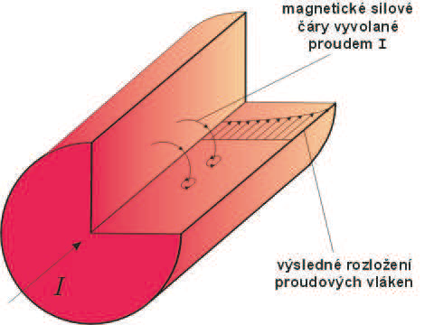
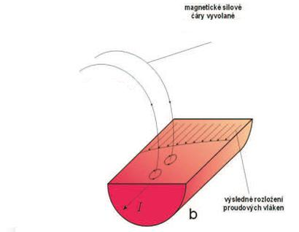
Skin effect - Introduction
Alternating current is ejected to edge of conductor due to the interaction of current from source and current produced by electromagnetic induction
Current flows mainly in thin layer at surface.
Its distribution depends on dimension, frequency and material parameters.
Active task(skin effect)
Passive task (eddy currents)
Magnetic field
Magnetic field
Distribution current field
Distribution current field

Slide 4
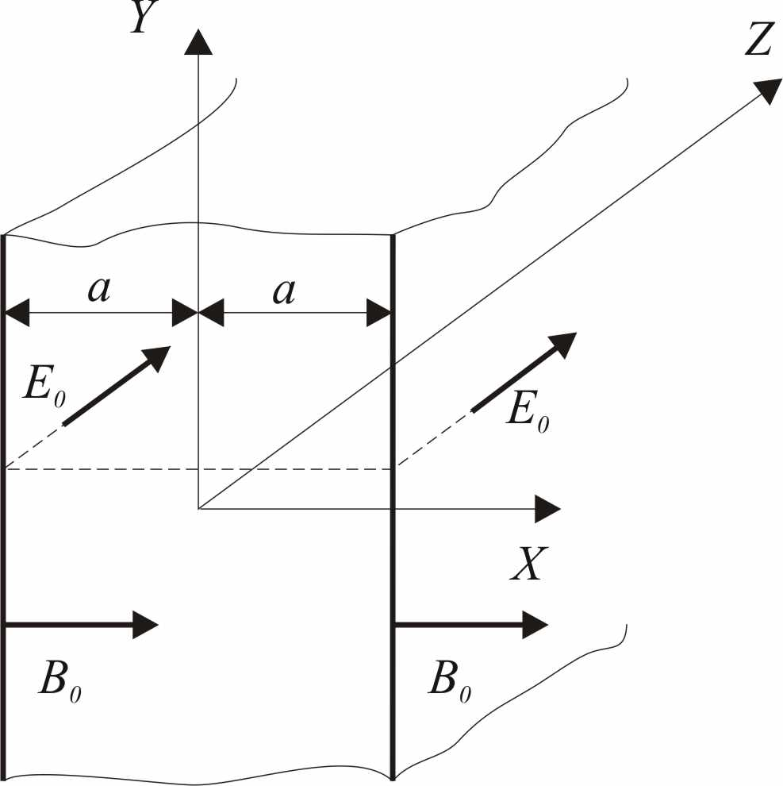
Skin effect – 1D solution for layer
The coordinate of electric field
Boundary conditions tangencial components
normal components
for x = a is E_{z} = E₀
for x = -a is E_{z} = E₀
Initial conditions is replaced by steady state for harmonic generation
Final solution for layer
where:

Slide 5
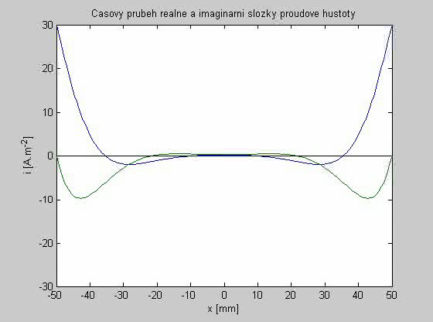
Real and imaginary component of current density in layer (1D solution)
Current distribution
  In given time
  Real and imaginary component
Parameters
  Width of layer 2a = 100mm.
  Frequency f = 50Hz.
  Conductivity σ = 6.10⁷ S/m – copper.
Surprising result:
  Part of current in the inner part flows in opposite direction.

Slide 6
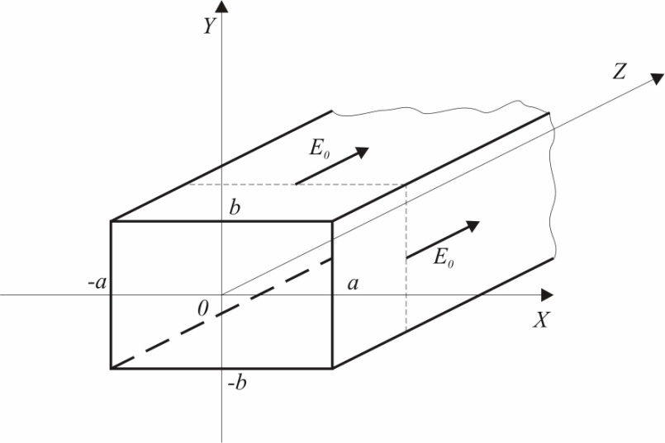
Skin effect in conductor with rectangle cross section – 2D solution
One field strength component E_{z}
Boundary condition
for x = a is E_{z} = E_{0 ,} for x = -a je E_{z} = E₀
for y = b is i E_{z} = E_{0 ,} for y = -b je E_{z} = E₀
Initial conditions is replaced by steady state for harmonic generation
Final solution for rectangle cross section
By substitution we find that boundary conditions are valid
Notes:
Doplnit, že platí okrajové podmínky.

Slide 7
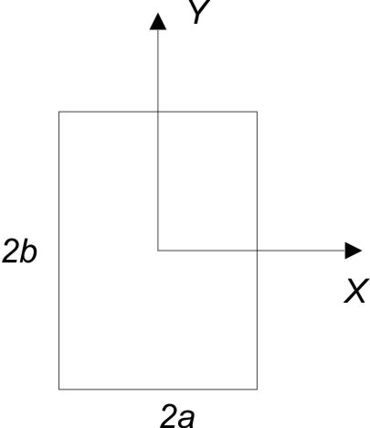
Visualization of 2D Skin Effect
Color map
  Low information content
Surface graph
  Suitable for time evolution
Parametric graphs
  At given time
  Along several lines
Frequency dependence for given line
  Most practical information
Geometry of conductor
Notes:
V

Slide 8
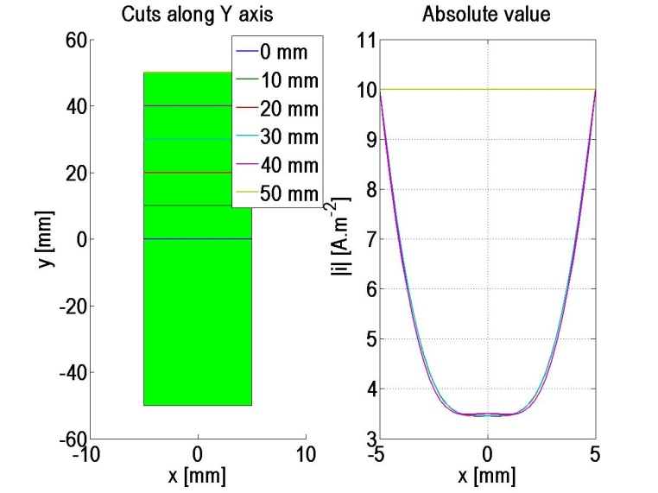
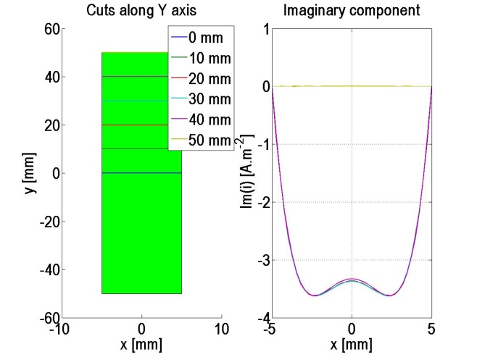
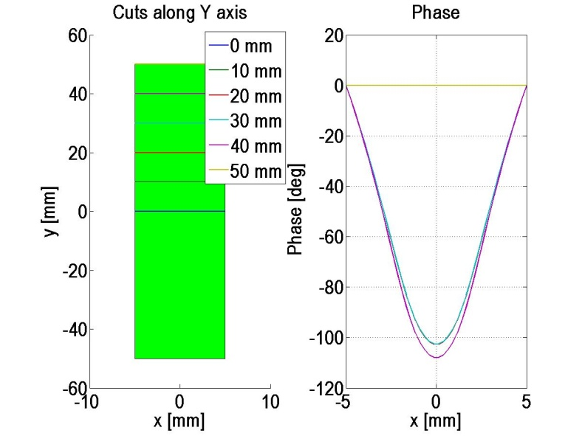
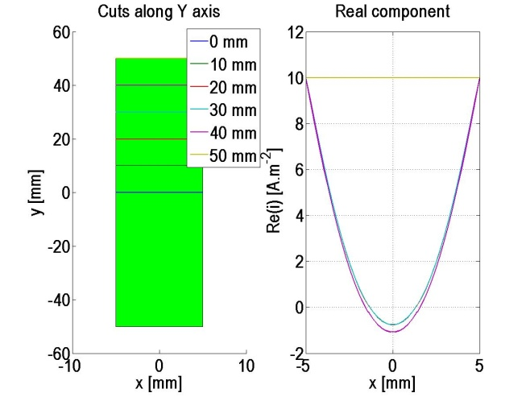
Parametric graphs along x axis
Current distribution does not change significantly in this case

Slide 9
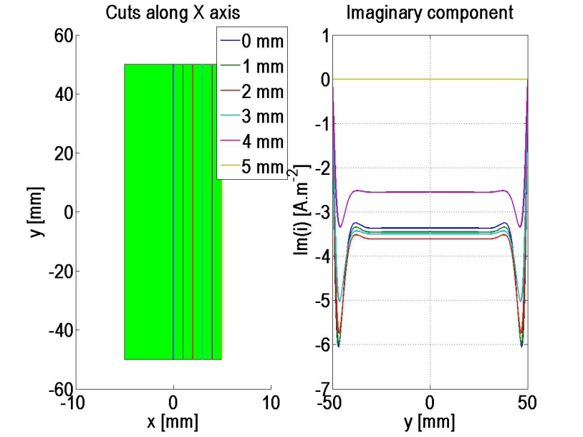
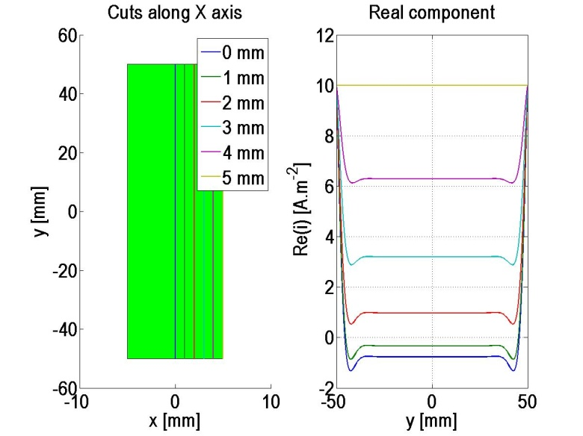
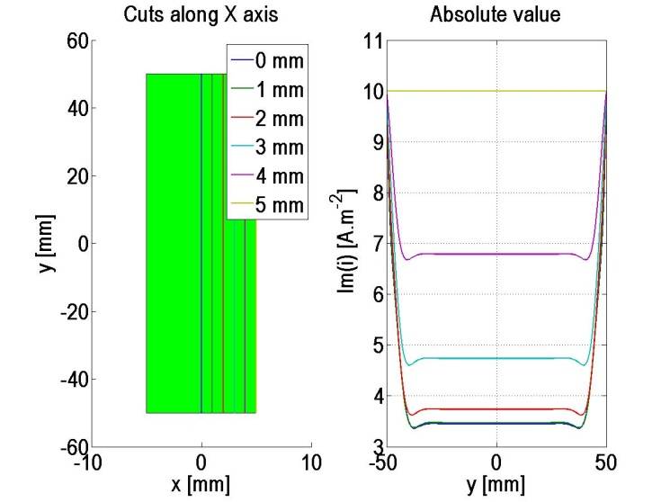
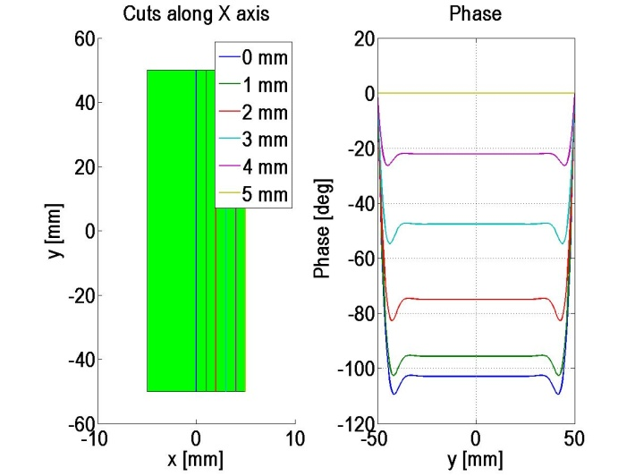
Parametric graphs along y axis

Slide 10
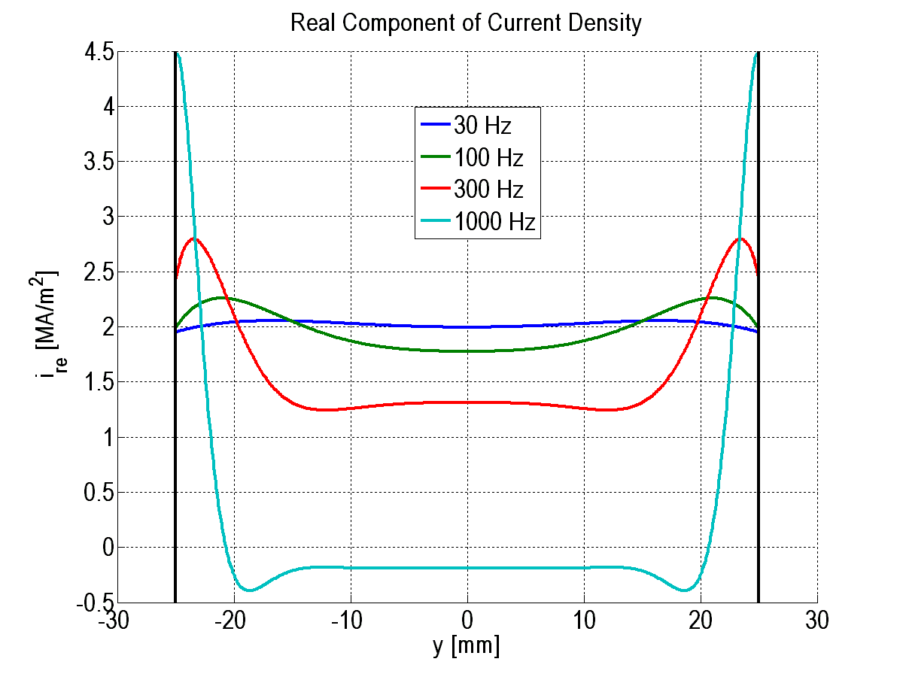
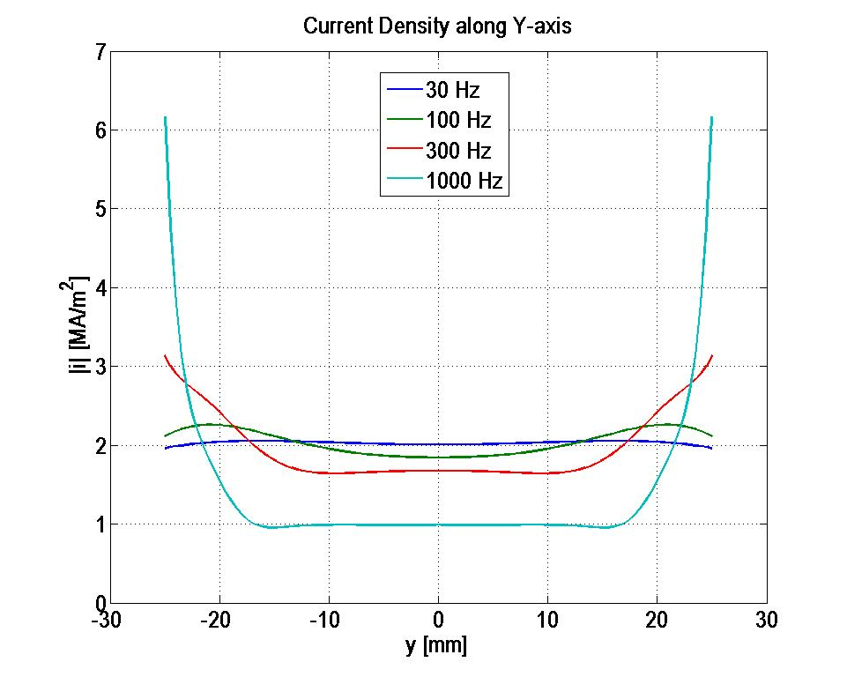
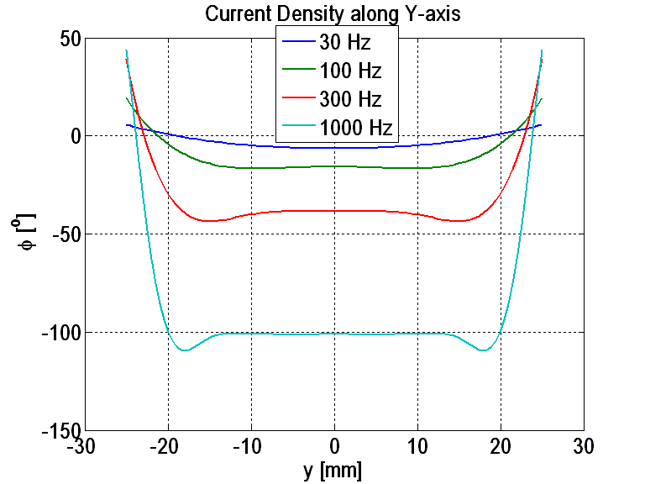
Frequency dependence of current density – real component, amplitude and phase
Real component of current density
has small negative values at high
frequencies.
Notes:
Mela by byt realna slozka, amplituda a faze

Slide 11
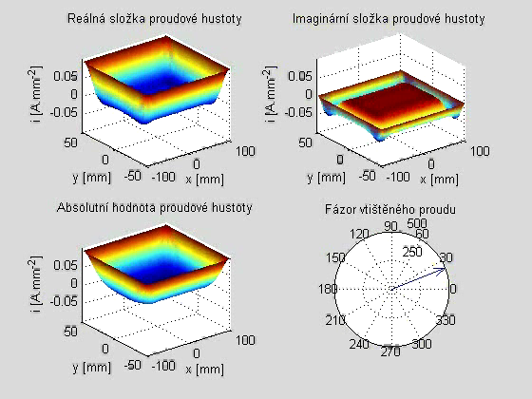
Time Evolution of Current Density – Real Component
2D damped oscillation are visible,
in analogy to 1D case. They are
extremes of negative current.
Notes:
Simulace pro realnou slozku

Slide 12
Verification of Current Distribution - Idea
Simple experiment for current distribution measurement is not possible.
The only measurable effect is the magnetic field generated by current.
Analytical formula only for thin straight conductor
Field from thick conductor is superposition of elementary fields from its parts in used grid
The frequency dependence is the simplest experimental verification

Slide 13
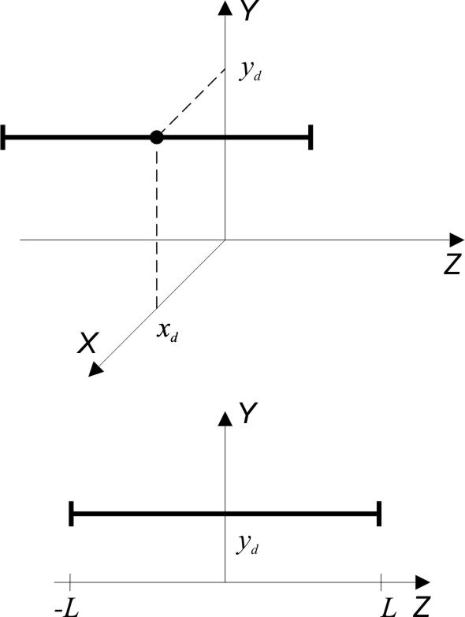
Magnetic field of straight conductor of finite length
General Biot Savat Law in differential form
Analytical formulae for flux density components of thin conductor
obtained by integration for given geometry
Real conductor is modeled by system of thin conductors.
Notes:
Vlozit geometrii

Slide 14
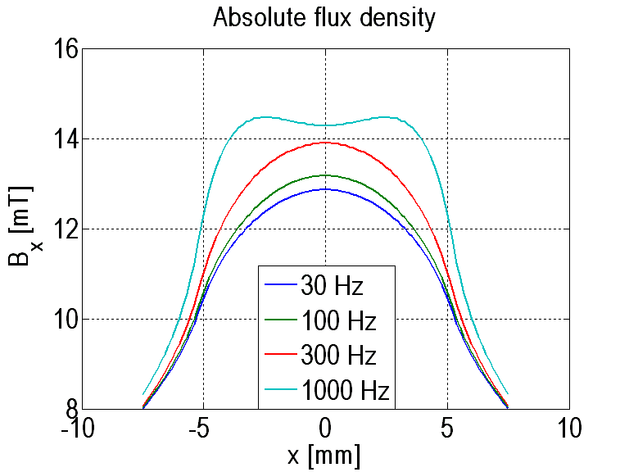
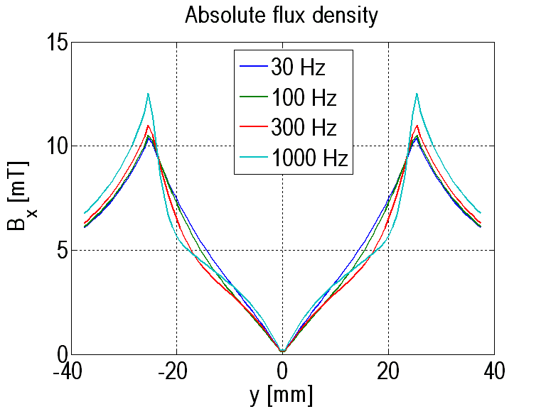
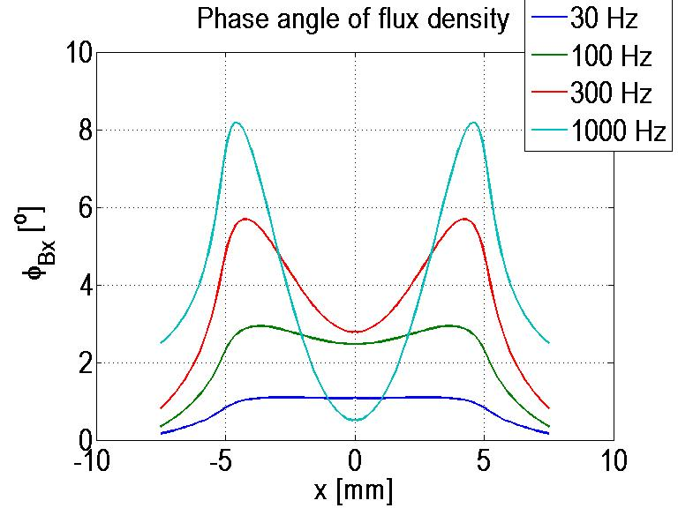
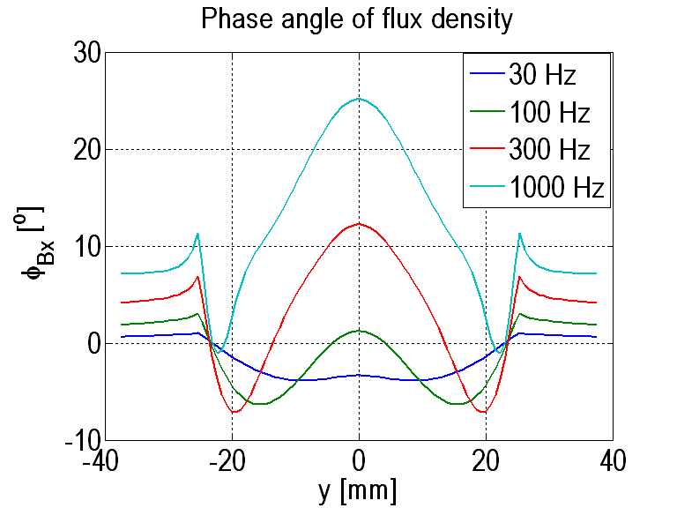
Effect of frequency on Bx component
Calculations are very close to wire surface.
Difference in amplitude (2 mT) and phase (8 deg) are measurable.

Slide 15
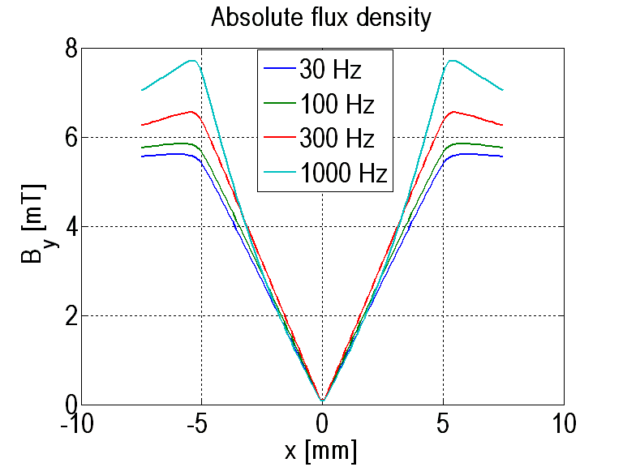
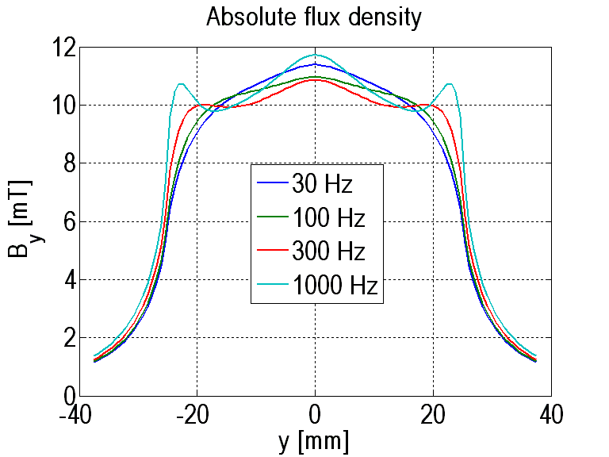
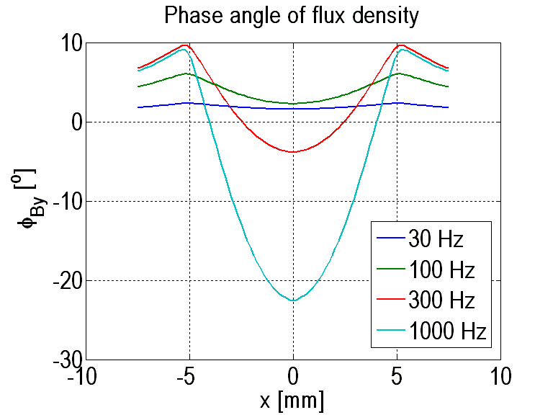
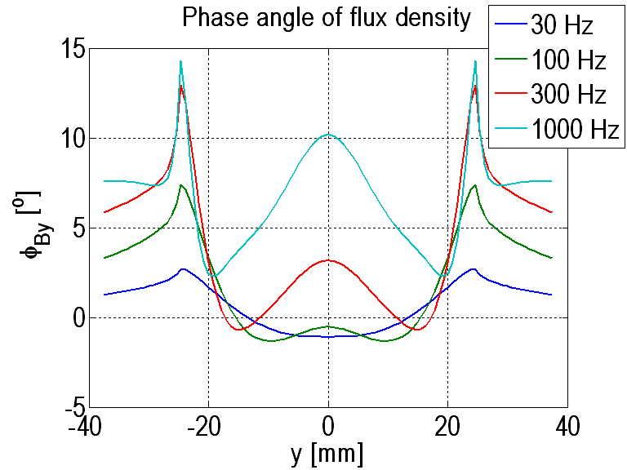
Effect of frequency on By component
Differences are low in amplitude.

Slide 16
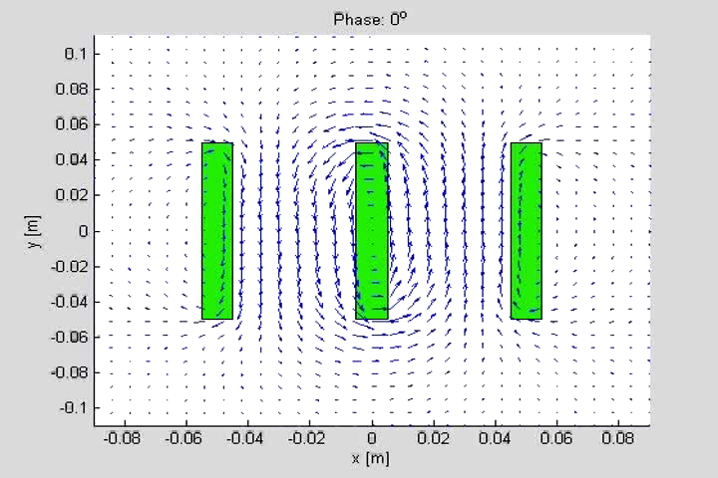
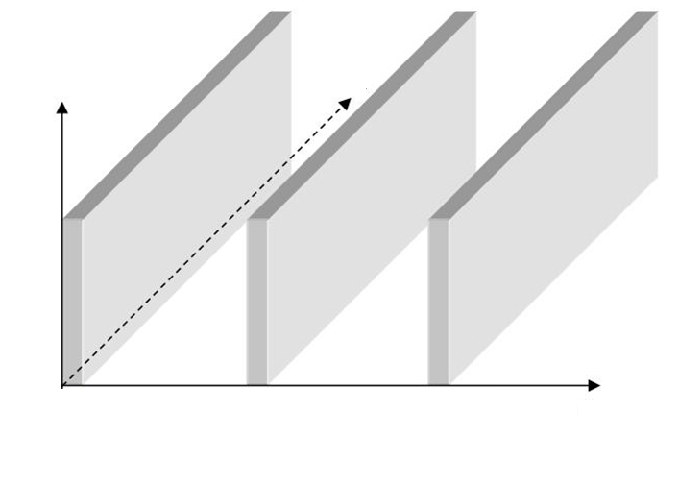
Application to three phase system driven by frequency 50 Hz, vector form of visualization
Flux vectors were calculated in planes perpendicular to conductors. Dynamical shape of magnetic field in three phase conductors is in these figures for important instants of time in a period.
z
y
The magnetic field is concentrated either in both the gaps between conductors or in the left or right gap. The rotating magnetic field is almost in whole the area. The end point of each vector forms are an ellipse .
x

Slide 17
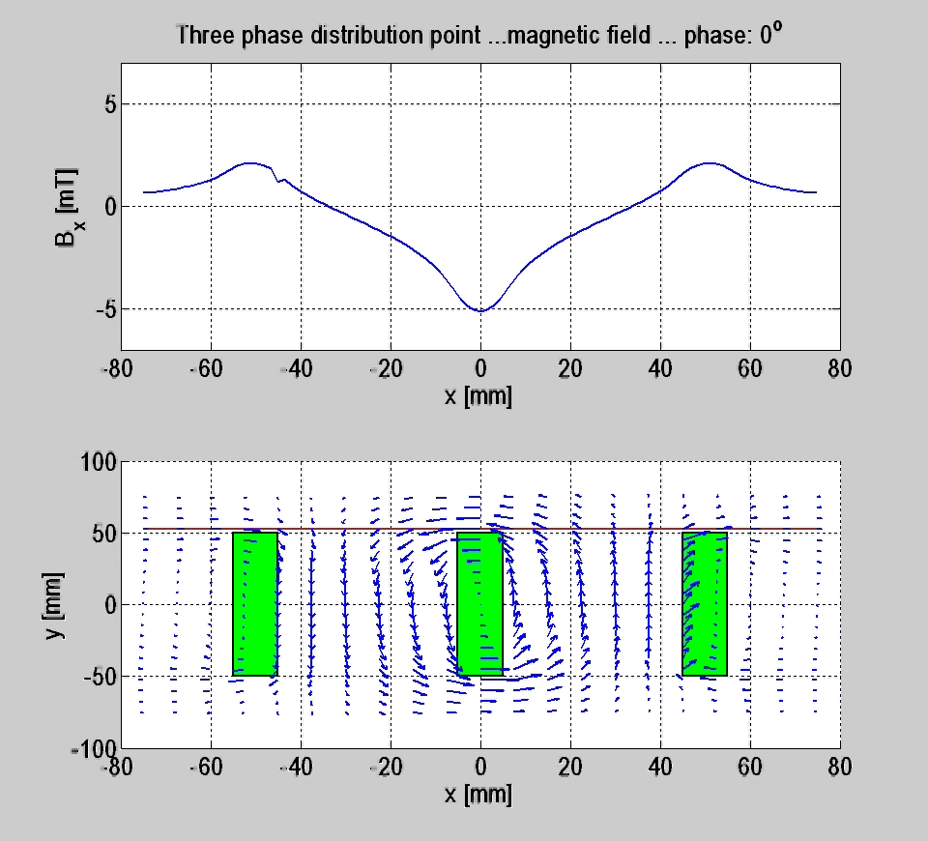

Slide 18
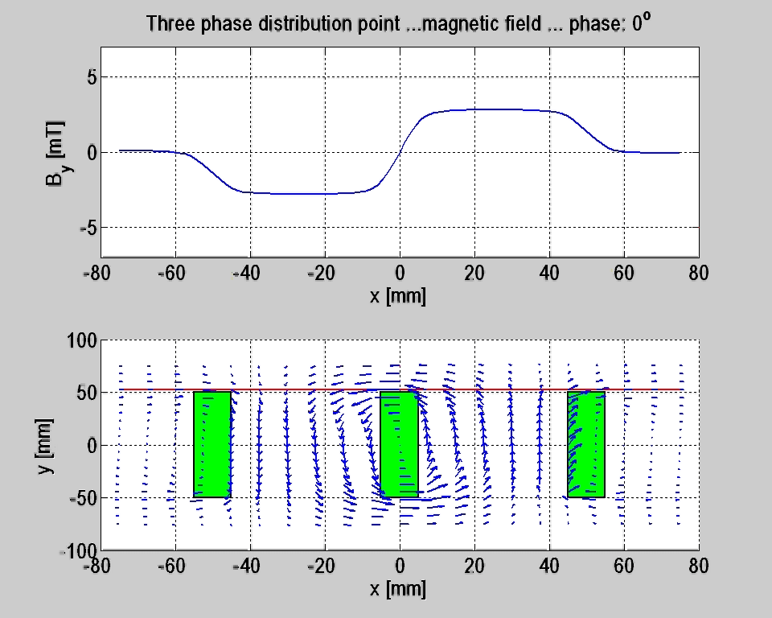

Slide 19
Conclusion
Important formulae were derived and extended calculation of skin effect were performed.
All calculation and visualization were made by MATLAB, which is very effective instrument for technical calculation. The speed can be improved by cluster application.
The results need experimental verification, which is in preparation.

Slide 20
Thankyou for your attention

