Slide 1
CZECH TECHNICAL UNIVERSITY IN PRAGUE
Faculty of electrical engineering
Study of SAR focusing by array of stripline TEM mode applicators
Barbora Vrbová, Jan Vrba

Slide 2
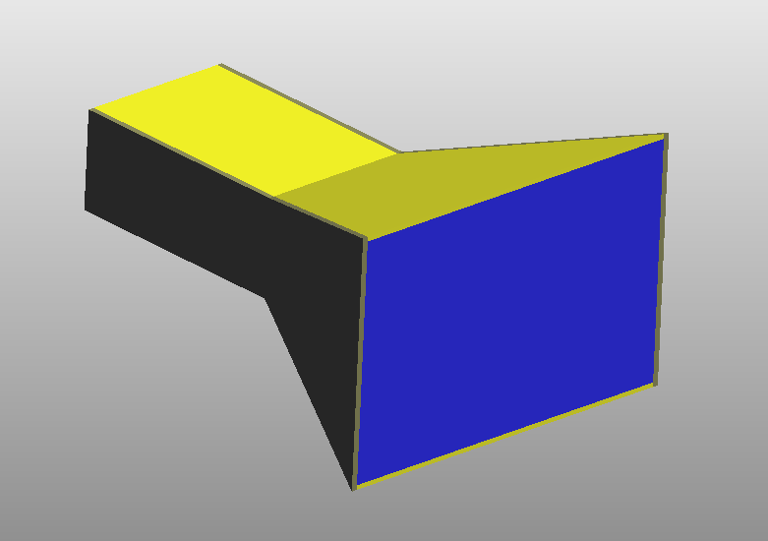
Microwave stripline applicator with TEM mode
Working frequency: 434 MHz
Upper and bottom strips are made from copper
Lateral sides are from lossless dielectric material
Air or water inside

Slide 3
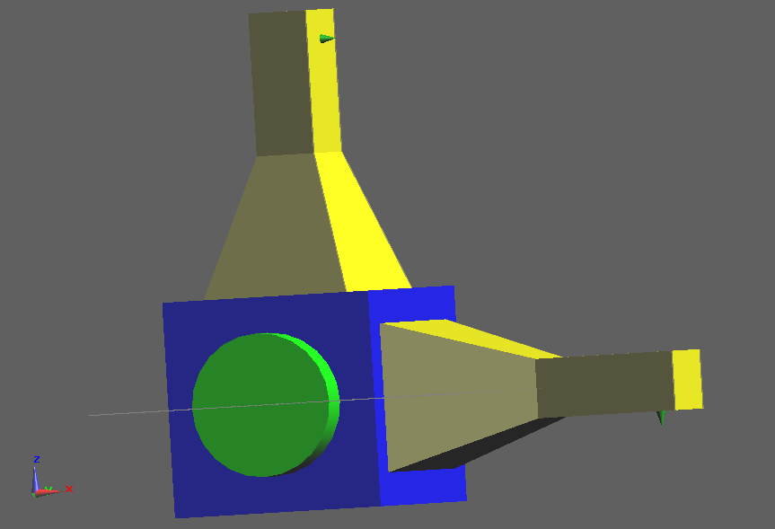
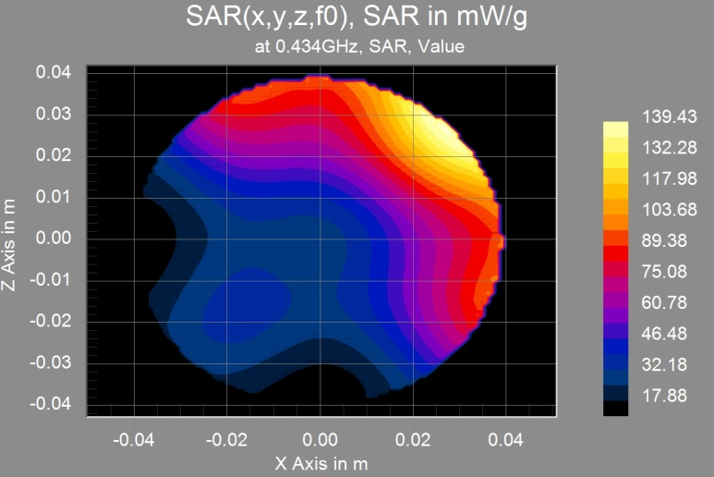
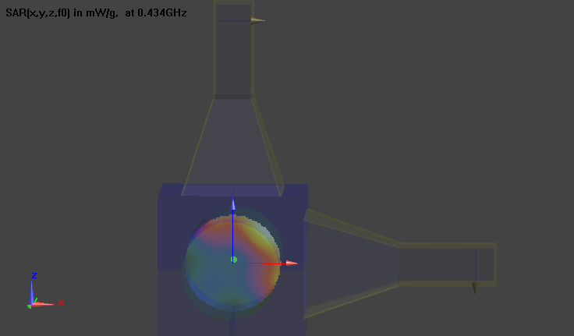
Composition of two applicators
Model of composition
SAR distribution

Slide 4
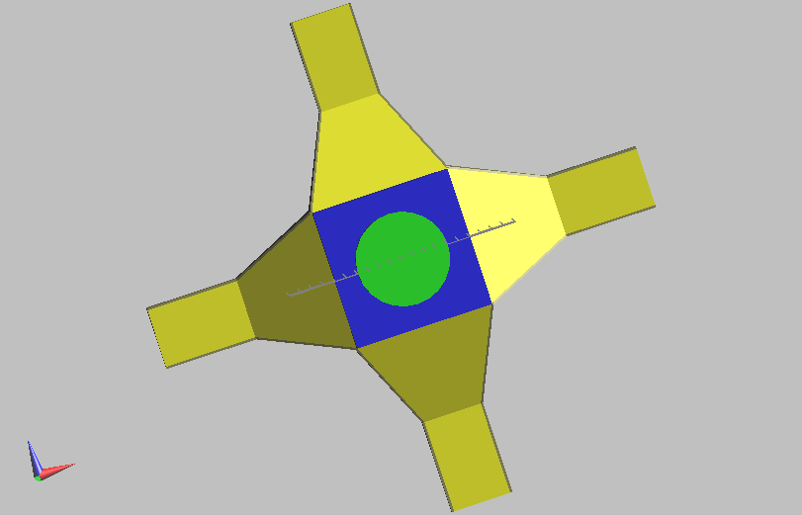
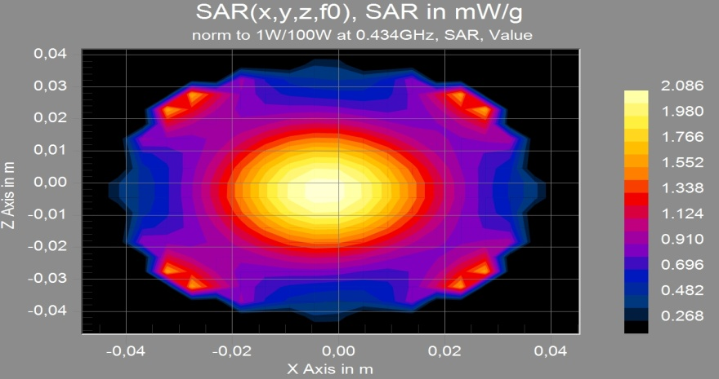
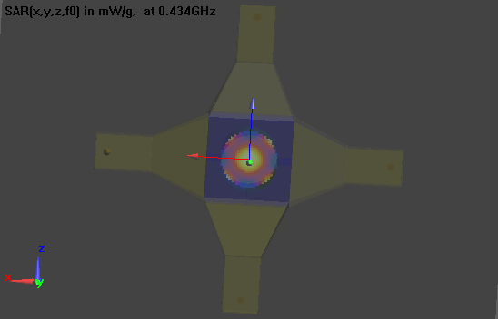
Composition of four applicators
Model of composition
SAR distribution

Slide 5
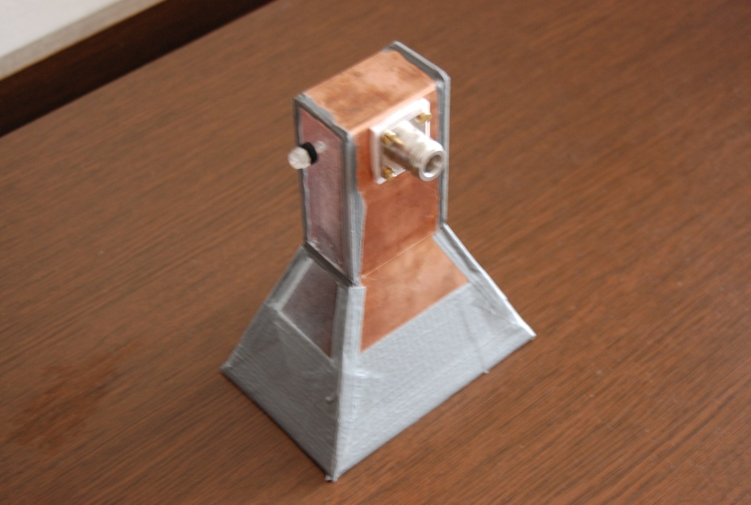
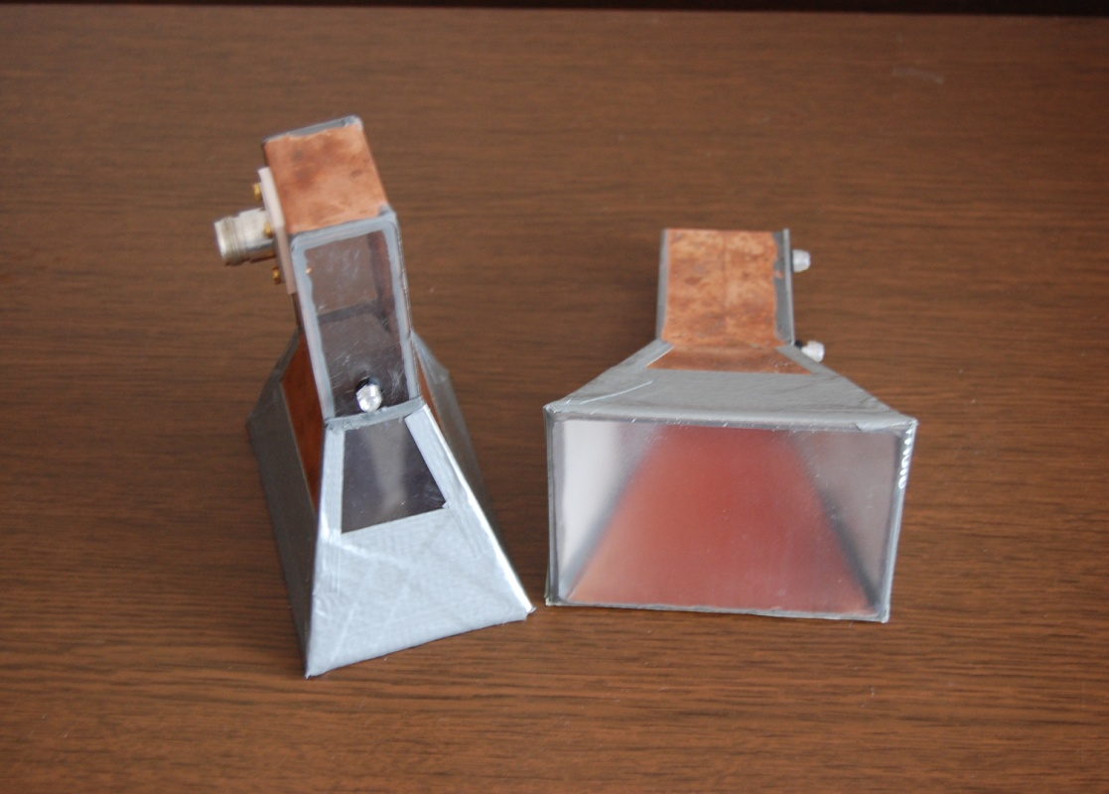
Thank you

